Slide 1


Movie Recommendation System
Arka Dyuti Kundu
4th Year
CSE
Roll - 147

Slide 2
INTRODUCTION
What is a Recommender System?
A Recommender System refers to a system that is capable of predicting the future preference of a set of items for a user, and recommend the top items. One key reason why we need a recommender system in modern society is that people have too much options to use from due to the prevalence of Internet. In the past, people used to shop in a physical store, in which the items available are limited. For instance, the number of movies that can be placed in a Blockbuster store depends on the size of that store. By contrast, nowadays, the Internet allows people to access abundant resources online. Netflix, for example, has an enormous collection of movies. Although the amount of available information increased, a new problem arose as people had a hard time selecting the items they actually want to see. This is where the recommender system comes in.

Slide 3
Types of Recommender System:
There are three different types of Recommender Systems:
Collaborative Filtering
Content-Based Filtering
Hybrid Recommendation Systems (Collaborative + Content)

Slide 4
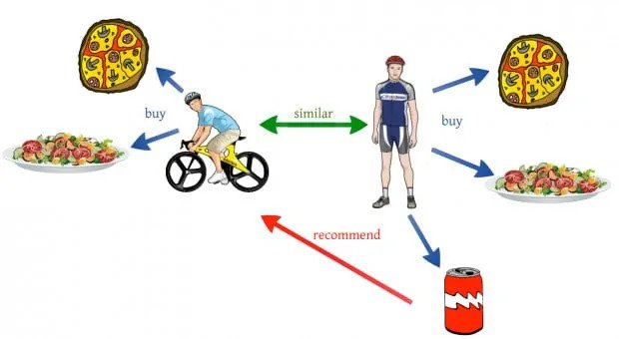
Collaborative Filtering
Collaborative filtering methods are based on collecting and analysing a large amount of information on users’ behaviours, activities or preferences and predicting what users will like based on their similarity to other users. A key advantage of the collaborative filtering approach is that it does not rely on machine analysable content and therefore it is capable of accurately recommending complex items such as movies without requiring an “understanding” of the item itself. Many algorithms have been used in measuring user similarity or item similarity in recommender systems. For example, the k-nearest neighbor (k-NN) approach and the Pearson Correlation.

Slide 5
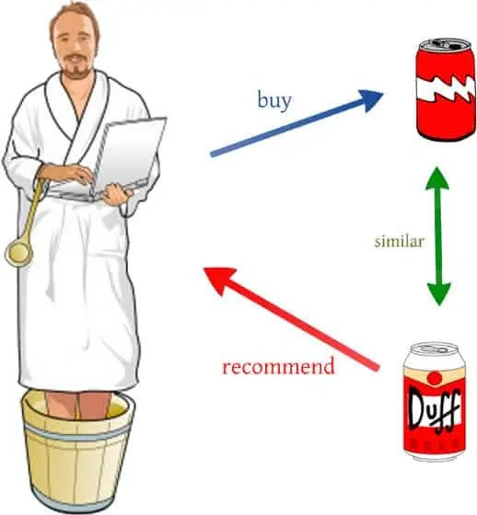
Content-Based Filtering
Content-based filtering methods are based on a description of the item and a profile of the user’s preference. In a content-based recommendation system, keywords are used to describe the items; beside, a user profile is built to indicate the type of item this user likes. In other words, these algorithms try to recommend items that are similar to those that a user liked in the past (or is examining in the present). In particular, various candidate items are compared with items previously rated by the user and the best-matching items are recommended. This approach has its roots in information retrieval and information filtering research.

Slide 6
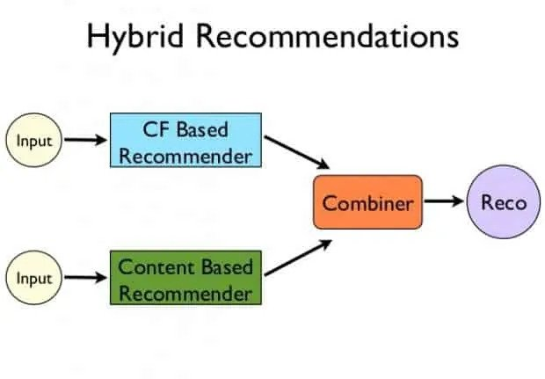
Hybrid Recommendation Systems
Recent research has demonstrated that a hybrid approach, combining collaborative filtering and content-based filtering could be more effective in some cases. Hybrid approaches can be implemented in several ways, by making content-based and collaborative-based predictions separately and then combining them, by adding content-based capabilities to a collaborative-based approach (and vice versa), or by unifying the approaches into one model. Several studies empirically compare the performance of the hybrid with the pure collaborative and content-based methods and demonstrate that the hybrid methods can provide more accurate recommendations than pure approaches. These methods can also be used to overcome some of the common problems in recommendation systems such as cold start and the sparsity problem.

Slide 7
My Implementation:
In this project I have taken the Collaborative Filtering based approach. For creating my model I used KNN algorithm along with cosine similarity metric to fulfil my goal. So let’s discuss about this algorithm, along with the metric.
GitHub Link – github.com/ArkDy1312/Movie-Recommendation-System

Slide 8
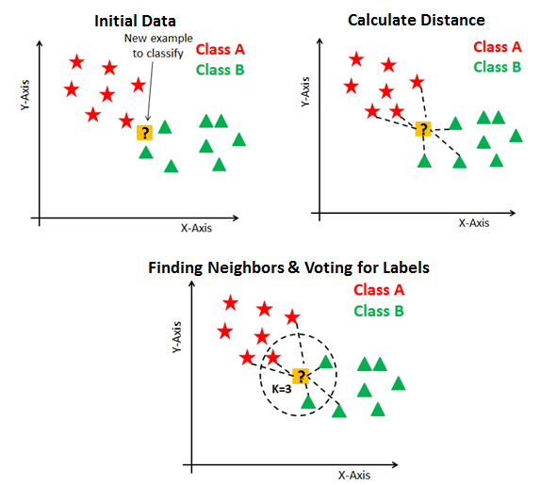
kNN Unsupervised Algorithm:
A k-nearest-neighbor is a data classification algorithm that attempts to determine what group a data point is in by looking at the data points around it.
An algorithm, looking at one point on a grid, trying to determine if a point is in group A or B, looks at the states of the points that are near it. The range is arbitrarily determined, but the point is to take a sample of the data. If the majority of the points are in group A, then it is likely that the data point in question will be A rather than B, and vice versa.
The k-nearest-neighbor is an example of a "lazy learner" algorithm because it does not generate a model of the data set beforehand. The only calculations it makes are when it is asked to poll the data point's neighbors. This makes k-nn very easy to implement for data mining.
The unsupervised algorithm basically does not have a testing phase, hence it uses the whole dataset for training the model instead of splitting the dataset into train and test sub-datasets.

Slide 9
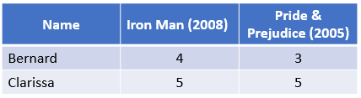
Cosine Similarity:
Cosine similarity is a method to measure the difference between two non zero vectors of an inner product space. See the example below to understand.
Suppose I want to check if Bernard and Clarissa have similar movie preferences, and I only have two movie reviews. The reviews are scores from 1 to 5, where 5 is the best score and 1 the worst, and 0 means that a person has not watched the movie.

Slide 10

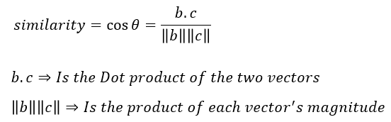
I can represent each person’s reviews in a separate vector.
Vector b represents Bernard and vector c Clarissa.
The cosine similarity will measure the similarity between these two vectors which is a measurement of how similar are the preferences between these two people.
In the image, below each vector represents a person’s preferences and they have an angle θ between them. Similar vectors will have a lower angle θ, and dissimilar vectors (different film preferences) will have bigger θ.

Slide 11
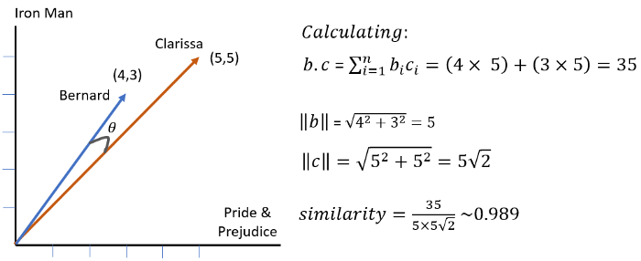
In the example above the similarity 0.989 is close to the maximum value of 1, this means that given only two movie reviews the two users have similar preferences.
Theoretically, the cosine similarity can be any number between -1 and +1 because of the image of the cosine function, but in this case, there will not be any negative movie rating so the angle θ will be between 0º and 90º bounding the cosine similarity between 0 and 1. If the angle θ = 0º =>cosine similarity = 1, if θ = 90º => cosine similarity =0.

Slide 12
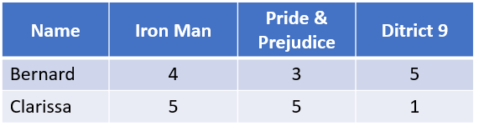
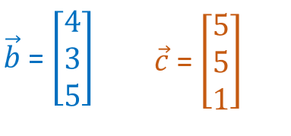
The cosine similarity can be calculated for more than 2 movies. In the example below I will add the ratings for a movie that Bernard liked and Clarissa disliked this should decrease cosine similarity value.
The new vectors are:

Slide 13
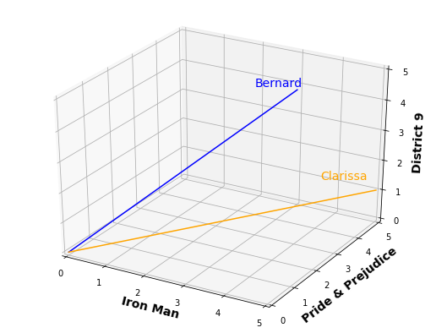
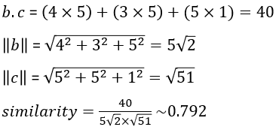
The plot has 3 dimensions now:
Calculating the similarity:
The similarity has reduced from 0.989 to 0.792 due to the difference in ratings of the District 9 movie. The cosine can be calculated in Python using the Sklearn library.

Slide 14
Applications:
Recommender Systems are used by many companies, for example:
Netflix uses it to recommend similar movies to their users
Amazon uses it to recommend similar products to their users
YouTube uses it to recommend similar videos to their users
And many more…

Slide 15
THANK YOU!

